Slide 1
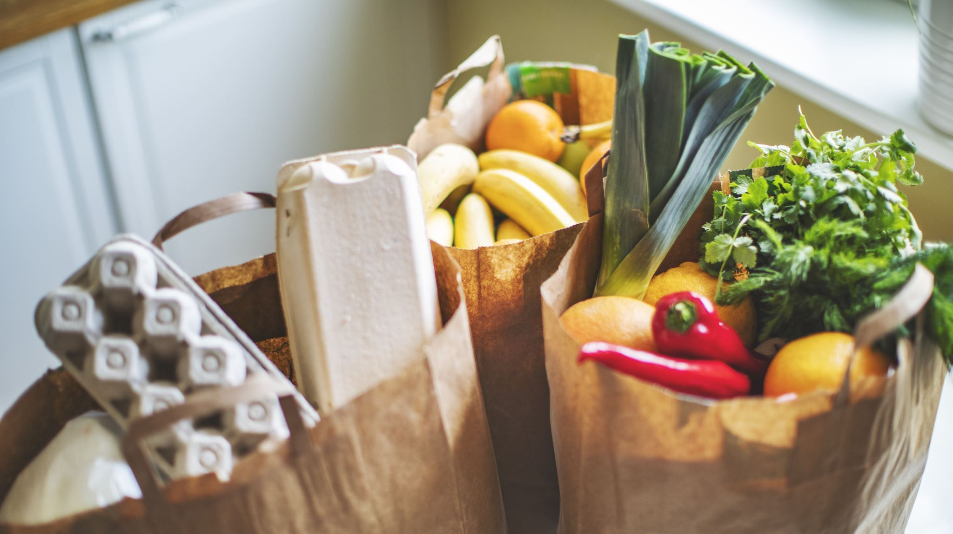
Food Delivery App
Streamlining Food Delivery Operations

Slide 2
Introduction
The Food Delivery App is a modern solution catering to the increasing demand for convenient food delivery services. In today's fast-paced lifestyle, people seek efficient ways to order and receive food, prompting the development of user-friendly platforms like ours. The app serves as a bridge between customers and food vendors, offering a seamless experience from browsing menus to doorstep delivery. Through this presentation, i aim to delve into the app's features, architecture, and technologies, showcasing its ability to revolutionize the food delivery experience for both users and vendors.

Slide 3
Overview of the project: frontend, backend, and admin interfaces.

Slide 4
Frontend
The frontend of the Food Delivery App serves as the user interface through which customers interact with the platform. It provides a seamless and intuitive experience for browsing food items, placing orders, and tracking deliveries. Key features of the frontend include:
User-friendly interfaces for browsing food items, viewing menus, and placing orders.
Integration with payment gateways for secure online transactions
Real-time order tracking to keep users informed about the status of their deliveries
Responsive design to ensure accessibility across devices, including desktops, tablets, and smartphones.

Slide 5
Backend
The backend of the Food Delivery App serves as the core infrastructure responsible for processing orders, managing inventory, and handling business logic. It acts as the bridge between the frontend and the database, orchestrating various operations to ensure smooth operation of the application. Key functionalities of the backend include:
User authentication and authorization to secure access to the platform's features.
Integration with third-party APIs for services such as geolocation, payment processing, and notifications.
Management of orders, including order placement, processing, and fulfillment.
Inventory management to track stock levels, update product availability, and manage suppliers.
Database operations for storing and retrieving data related to users, orders, menus, and transactions.
Implementation of business logic, including pricing calculations, discounts, and promotions

Slide 6
I utilized several dependencies in my project for various functionalities. Firstly, bcrypt was employed for secure password hashing and storage, enhancing user authentication security. Body-parser facilitated the parsing of incoming request bodies in Express.js, aiding in data extraction from HTTP requests. Cors was essential for enabling Cross-Origin Resource Sharing (CORS) in Express.js, allowing controlled access to resources from different origins. Dotenv helped load environment variables from a .env file, ensuring sensitive configuration data remained secure. Express served as the web server framework, handling HTTP requests and routing, providing a robust foundation for building RESTful APIs. Jsonwebtoken was utilized for generating and verifying JSON Web Tokens (JWTs), enabling secure authentication and authorization mechanisms. Mongoose simplified interactions with MongoDB databases by offering schema-based solutions and data validation. Multer was necessary for handling multipart/form-data, particularly file uploads, streamlining file handling in web applications. Nodemon served as a developmthe development workflow. Stripe was integrated for processing payments and managing transactions securely, enabling seamless e-commerce functionality. Lastly, Validator was used for input validation and sanitization, ensuring data integrity and preventing security vulnerabilities in user input.

Slide 7
Admin
The admin interfaces of the Food Delivery App provide tools and dashboards for managing the platform's operations, content, and user base. They empower administrators and business owners to oversee various aspects of the application and make informed decisions to optimize performance. Key features of the admin interfaces include:
Tools for managing menus, categories, and pricing to update offerings and adjust inventory levels.

Slide 8
System Architecture
The Food Delivery App follows a client-server architecture, comprising multiple layers to facilitate seamless communication and interaction between different components. The architecture consists of:
Client Side (Frontend):
Developed using React, a JavaScript library for building user interfaces.
Responsible for rendering the user interface, handling user interactions, and making requests to the server.
Utilizes components such as Navbar, Sidebar, Add, List, and Orders to provide a user-friendly experience.
Communicates with the server via HTTP requests to perform various operations, such as fetching menu items, placing orders, and tracking deliveries.

Slide 9
Server Side (Backend):
Built using Node.js, a runtime environment for executing JavaScript code server-side.
Utilizes Express, a web application framework for Node.js, to handle routing, middleware, and HTTP requests.
Implements RESTful APIs to expose endpoints for performing CRUD (Create, Read, Update, Delete) operations on resources such as food items, orders, and user data.
Manages business logic, database interactions, and authentication/authorization processes.
Database Layer:
Relies on MongoDB, a NoSQL database, to store and manage application data.
Stores collections of documents representing entities such as food items, orders, users, and administrative information.
Utilizes MongoDB's flexible schema to accommodate diverse data structures and support scalability.
External Services:
Integrates with external services such as payment gateways, geolocation APIs, and notification services to enhance functionality.
Enables features like secure online payments, real-time order tracking, and automated notifications for order updates

Slide 10
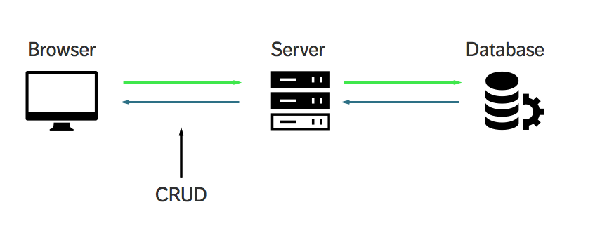
Client-Server Interaction Diagram
In the client-server interaction diagram:
The client (frontend) initiates an HTTP request to the server to perform a specific action, such as fetching menu items or placing an order.
The server (backend) processes the request, performs the necessary operations, and generates an appropriate HTTP response.
The response is sent back to the client, containing the requested data or confirming the success/failure of the operation.

Slide 11
Technologies Used:
React: A JavaScript library for building user interfaces.
Node.js: A runtime environment for executing JavaScript code server-side.
Express: A web application framework for Node.js, used for handling routing and middleware.
MongoDB: A NoSQL database used for storing and managing application data.
Vite: A build tool that provides a fast development server and optimized production builds for modern JavaScript projects.
This architecture leverages modern technologies, including Vite, to create a scalable, efficient, and responsive food delivery application, ensuring a seamless experience for both customers and businesses.

Slide 12

Live Demo

Slide 13
Challenges Faced
Developing the Food Delivery Management System solo came with its set of unique challenges, particularly in the frontend development, which was built entirely from scratch. Some of the key challenges encountered during the project include:
State Management: Managing state across various components and ensuring synchronization between frontend and backend data presented challenges
Understanding Component Lifecycle :Grasping the concept of component lifecycle in React and knowing when to perform certain actions such as fetching data, updating state, or cleaning up resources can be confusing initially, leading to unexpected behavior or memory leaks
CSS Styling and Layout: Learning and applying CSS styling techniques to create visually appealing and responsive layouts, including flexbox, grid, and CSS animations, was overwhelming
Debugging and Troubleshooting: Identifying and fixing bugs, errors, or unexpected behaviors in the code, including syntax errors, logical errors, or runtime exceptions, requires patience

Slide 14
Future Enhancements
Feedback and Rating System
Dark Mode/Light Mode Support
Personalized Recommendations: Utilize machine learning algorithms to analyze user preferences, order history, and browsing behavior to provide personalized recommendations for food items, promotions, and special offers. Use techniques like collaborative filtering or content-based filtering to suggest relevant items to users.
Multi-language and Multi-currency Support:
Add support for multiple languages and currencies to cater to a diverse user base.Allow users to switch between languages and currencies dynamically and provide localized content, prices, and payment options based on their preferences.

Slide 15
Conclusion
the Food Delivery Management System presented offers a comprehensive solution for streamlining food delivery operations.
The introduction emphasized the importance of efficient management in the food industry, setting the stage for the project overview, which showcased its frontend, backend, and admin interfaces.
The system architecture was discussed, including the client-server interaction diagram and the technologies utilized, such as React, Node.js, Express, and MongoDB.
Key features such as adding items, listing items, and managing orders were explored, with a live demonstration showcasing their functionality.
Future enhancements were outlined

